Slide 1
#F02U From Zero to Useful Getting started with SaltStack
By @arielsanchezmor
V1.0

Slide 2
You can find this ppt and source code in blogs.arielsanchezmora.com
Or tweet @arielsanchezmor

Slide 3
Agenda
A bit about me
From zero to useful series
What’s Saltstack and why do I care?
Saltstack comparisons and concepts
How to install and start using
Information available from VMware

Slide 4
A bit about me
Costa Rican, currently living in Orlando
Resume stuff – TAM @ VMware
Big proponent of the vCommunity (vBrownBag, vExpert, VMUG, virtual Zooms, etc)
I started using Twitter in 2013 or so
I want to help other people present at VMUG!

Slide 5
From Zero To Useful series
Started these in vBrownBag.com with vRops
“Teach me like I’m a noob”
Sessions are about giving max value for time
There are no dumb questions
*Stand on the shoulders of giants*
Working doc - Github page

Slide 6
But wait there’s more!
https://github.com/arielsanchezmora/VMUG-Talks/tree/master/2021-02-25%20Northwest%20Regional%20VMUG
These slides, all important links and any lab instructions/exercises available to continue, and they will be updated as I learn more
I’m no expert, but we can all figure stuff out, it’s how we make our livelihood

Slide 7
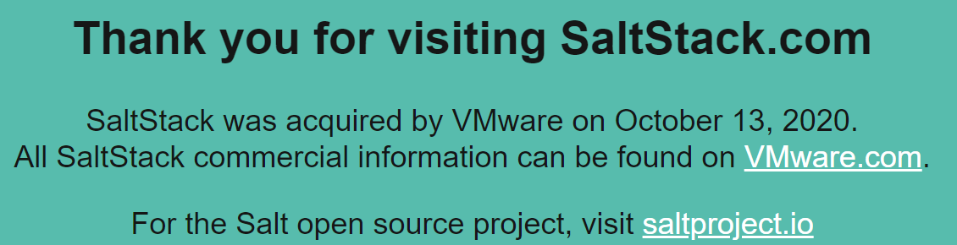
What’s Saltstack and why do I care
Saltstack is open source software for config management* with a focus on speed/scale
It was recently acquired by VMware
Filled a gap in the product line: managing VM config securely and fast

Slide 8
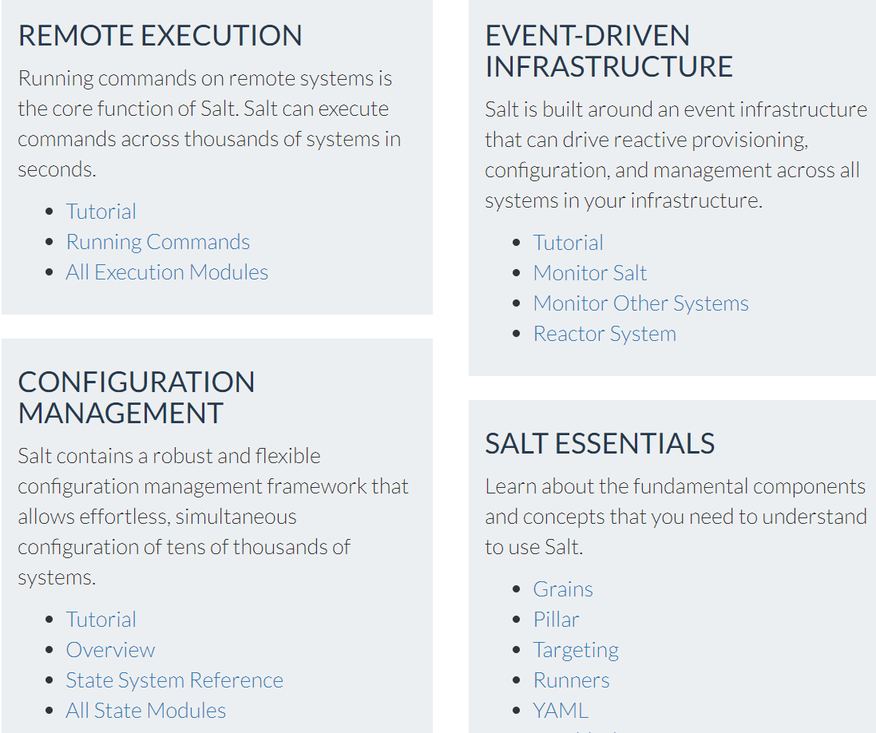
What’s Saltstack and why do I care
Saltstack can do more than config management:
docs.saltproject.io

Slide 9
What’s Saltstack and why do I care
Saltstack can do more than config management:
docs.saltproject.io

Slide 10
How is Saltstack similar
To other config management tools?
Open source project with Enterprise version
Allows one-time changes (run commands) or declarative infrastructure management (manage state)
Enables infrastructure as code
Uses YAML which is very readable
Based on Python

Slide 11
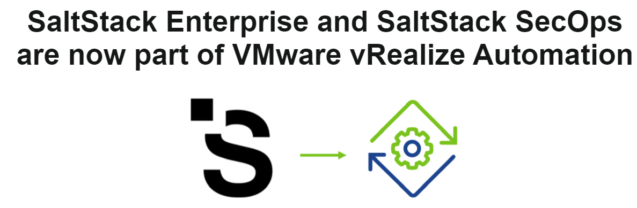
How is Saltstack different
To other config management tools?
Has its own efficient and secure communication protocol (AES encryption, ZeroMQ)
Offers the option to be agent based or agentless
Comes included in vRealize Automation Enterprise

Slide 12
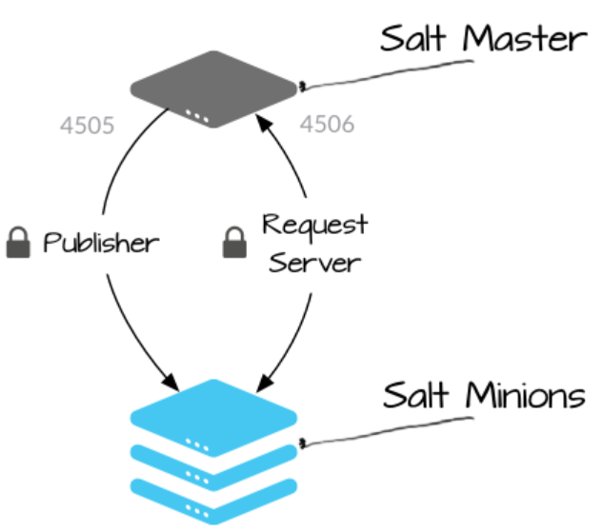
Saltstack in a nutshell
A Salt Master manages Minions – by default salt.domain.name (tcp 4505 and 4506)
Minions are listening for instructions from the master

Slide 13
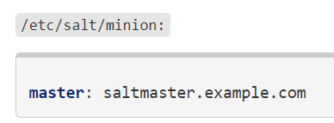
Saltstack in a nutshell
When the minion starts, it looks for the Salt Master through DNS or a config file, and does a SSH key authentication request
The Salt Master approves the key requests
You can also run salt locally without a master

Slide 14
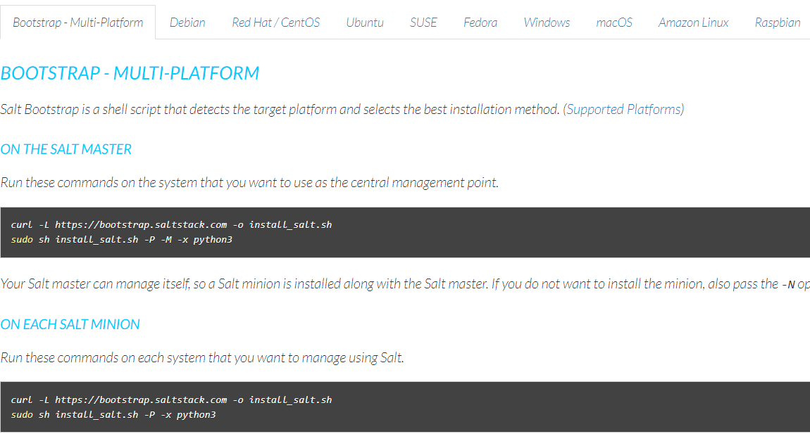
Minimal install
This is a great link to start:
http://repo.saltproject.io/index.html

Slide 15
Minimal install
To setup the master config and configure the encryption keys:
https://docs.saltproject.io/en/latest/ref/configuration/index.html
There are many options to ensure the minion and master are validated to avoid man in the middle attacks, or simply wrong configurations

Slide 16
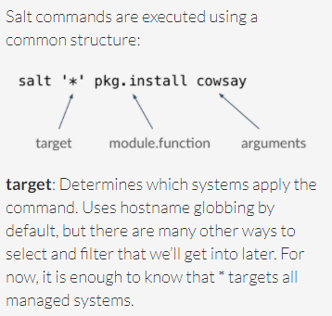
Once communication is flowing
You can now use the “salt” command and the modules available in salt to execute commands on the minions (in parallel ☺ )
salt '*' test.ping
salt '*' disk.usage
salt '*' pkg.install vim
salt '*' network.interfaces

Slide 17
Two excellent walkthroughs
The next few slides are a mashup of these two tutorials:
Understanding SaltStack
https://docs.saltproject.io/en/getstarted/system/index.html
Demo for remote execution and creating salt states
https://docs.saltproject.io/en/getstarted/fundamentals/

Slide 18
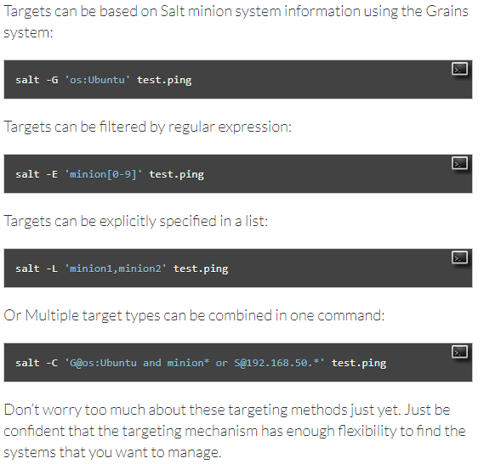
Targeting your minions (not *)
Extra points:
- Grains
Pillars
Compound
Nodegroups

Slide 19
Execution Modules
So many modules ☺
https://docs.saltproject.io/en/latest/ref/modules/all/index.html
Vendor modules
OS modules
Application config modules
Even modules to call Ansible playbooks
Python based

Slide 20
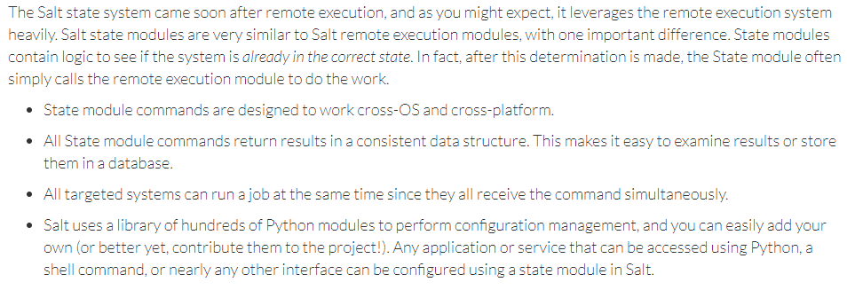
What is a Salt State?
The SLS is a representation of the state in which a system should be in.

Slide 21
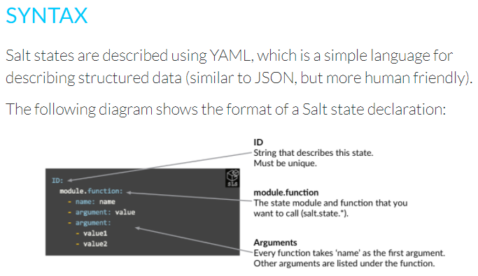
Creating Salt States
You can enforce configuration using state files – a text file that ends with .sls with YAML

Slide 22
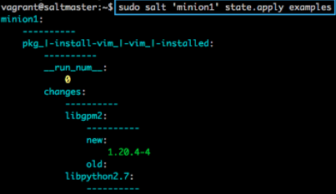

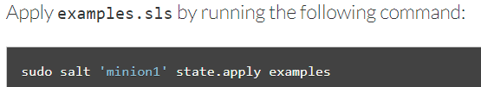
Salt States example 1
SaltStack config management tutorial
https://docs.saltproject.io/en/getstarted/config/functions.html

Slide 23
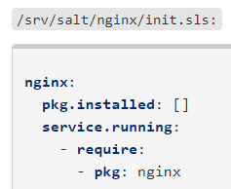
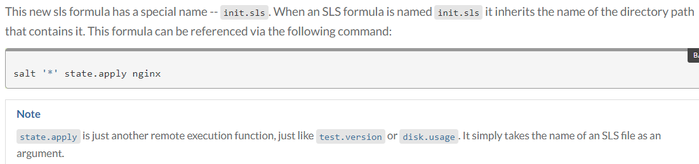
Salt States example 2
Managing state files in directories

Slide 24
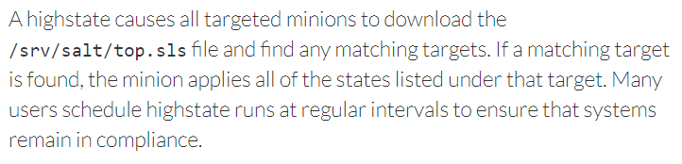
Top Files and Highstates
States and the Top file are the core of SaltStack’s configuration management.
The Top file is used to apply multiple state files to your Salt minions during a highstate. The states that are applied to each system are determined by the targets that are specified in the Top file.

Slide 25
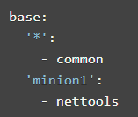

Top Files and Highstates
A top file defines which minions receive which state

Slide 26
VMware related info
Official product landing page:
https://www.vmware.com/products/vrealize-automation/saltstack-config.html
Latest version of documentation is now in the vRealize Automation docs:
https://docs.vmware.com/en/vRealize-Automation/index.html
VMware branded training, VMware official SaltStack Config training will appear on the v8.3 of vRealize Automation ICM, in March/April.

Slide 27
VMware related info
SaltConf20 Youtube Playlist:
https://www.youtube.com/playlist?list=PL9svBjLDUl__frIm2HOGPm1GrcVQkOZTe
How-to for SaltStack to talk to vCenter/ESXi:
https://docs.saltproject.io/en/latest/topics/cloud/vmware.html
VMware webinar introducing vRealize Automation SaltStack Config, requires BrightTalk registration:
https://www.brighttalk.com/webcast/18420/462197

Slide 28
More community resources
To join the SaltStack community Slack, you can sign up here https://saltstackcommunity.herokuapp.com/
Books! https://docs.saltproject.io/en/latest/
Tutorial hosted on DigitalOcean: https://www.digitalocean.com/community/tutorials/an-introduction-to-saltstack-terminology-and-concepts
Pluralsight training:
https://app.pluralsight.com/library/courses/getting-started-salt-open/table-of-contents

Slide 29
Setting up SaltStack on a Linux server
I’m using CentOS but you can use about any *nix
Do recommend installing through pip, makes sure python and pyvmomi are in compatible versions
This is the way I found it to “just work”

Slide 30
All installation commands v3
sudo yum update
sudo yum install python3
sudo pip3 install pyvmomi
sudo pip3 install ansible
That’s it!

Slide 31
Two ways of talking to vSphere
Traditional is using modules that rely on pyvmomi (python)
https://docs.saltproject.io/en/latest/topics/cloud/vmware.html

Slide 32
VMware REST API
Available since 6.5 and 6.7! Use the URI module to talk to a REST API
Literally, all the module does is allow you to make HTTP calls
- HTTP calls are GET, POST, PUT, DELETE, etc
- HTML responde codes (200 is good)
VMware includes a cool way to explore it

Slide 33
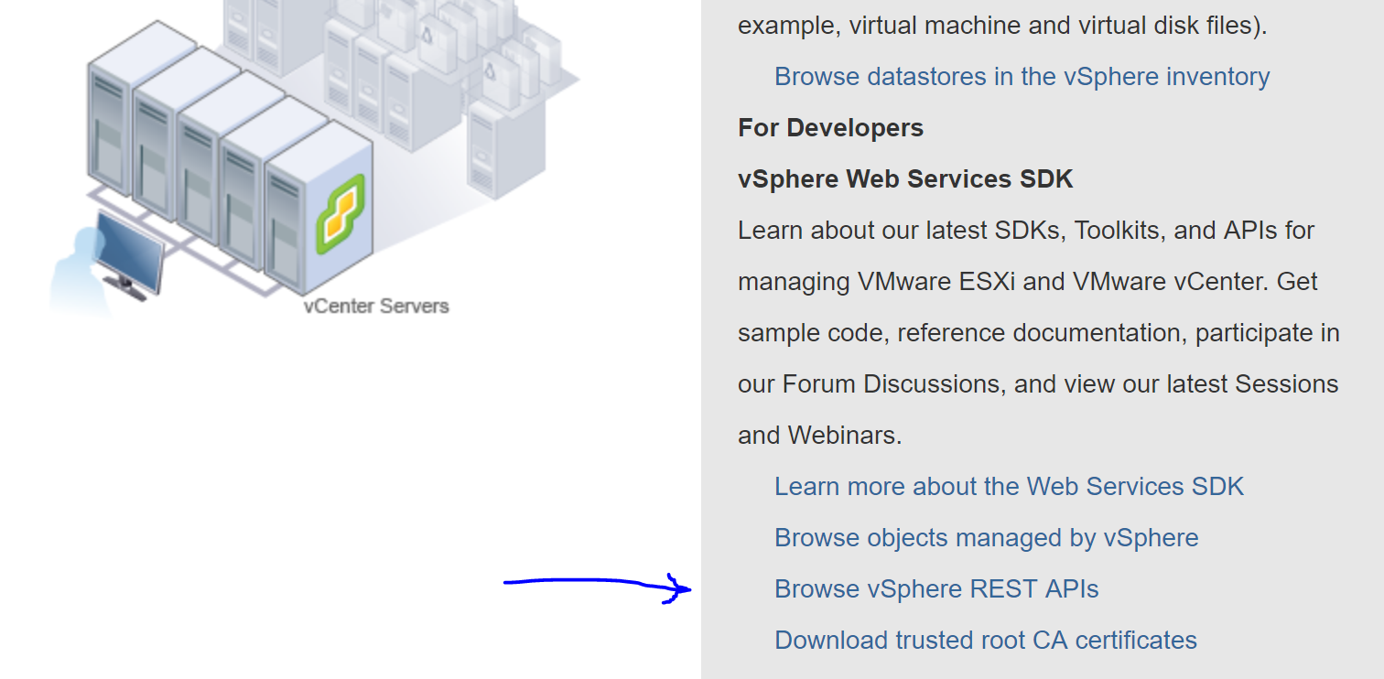
REST is easy
https://[[VC IP Address or FQDN]]/apiexplorer
Kyle Ruddy did an excellent vBrownBag video

Slide 34
We’re done ☺
Let’s get to trying things with the time we have!
Give feedback in the tool, and give feedback to me ☺

